Slide 1

Business Problem:
Objective:
The objective of the analysis is to Predict if the shipments are or will reach on time or not for an International E-Commerce company.

Slide 2
Project Name : Customer Analytics
Group Name : Group 6
Mentor Name : Mr. Vinod
Date : 31-Aug-2021

Slide 3
Project Architecture / Project Flow

Slide 4
Exploratory Data Analysis (EDA)

Slide 5
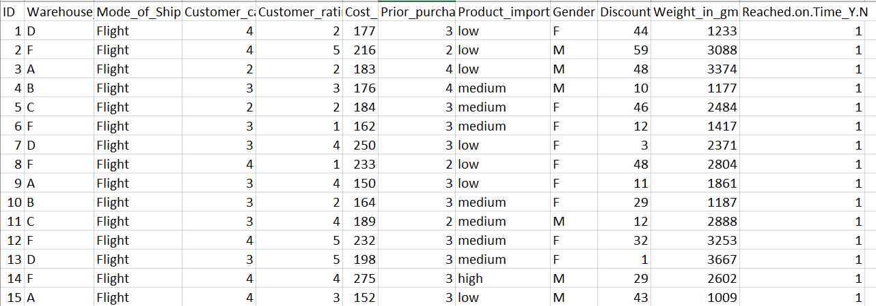
Data set details
No. of columns: 12
No. of rows: 10999
Colum with Unique Values: ID [contains ID no. of customer]
Missing Values: Null
Na Values: Null
X_variables: Warehouse_block, Mode_of_Shipment, Customer_care_calls, Customer_rating, Cost_of_the_Product, Prior_purchases, Product_importance, Gender, Discount_offered, Weight_in_gms
Y_variable: Reached.on.Time_Y.N

Slide 6

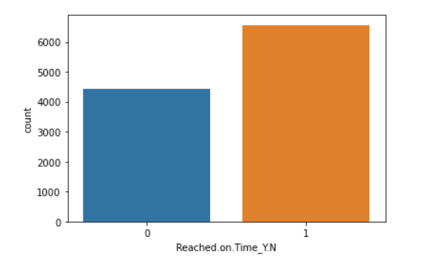
59.66% of products have not reached on time.
40.33% of products have reached on time.

Slide 7
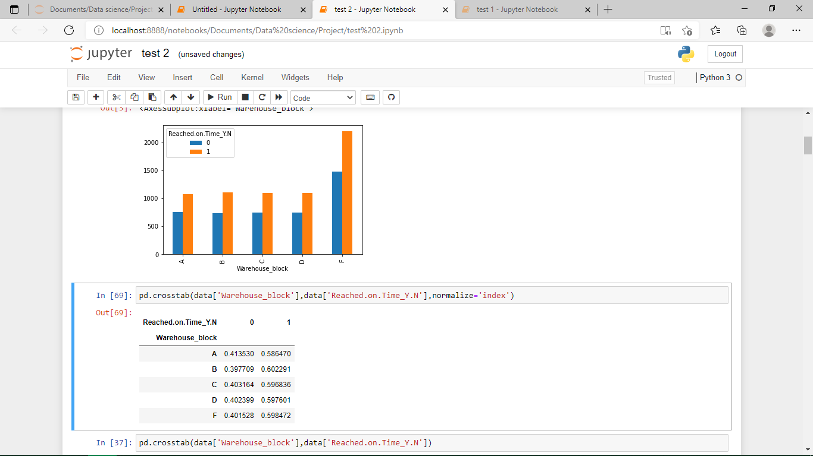
Less variance is found between all 5 Warehouse block in delivering shipment on time.

Slide 8
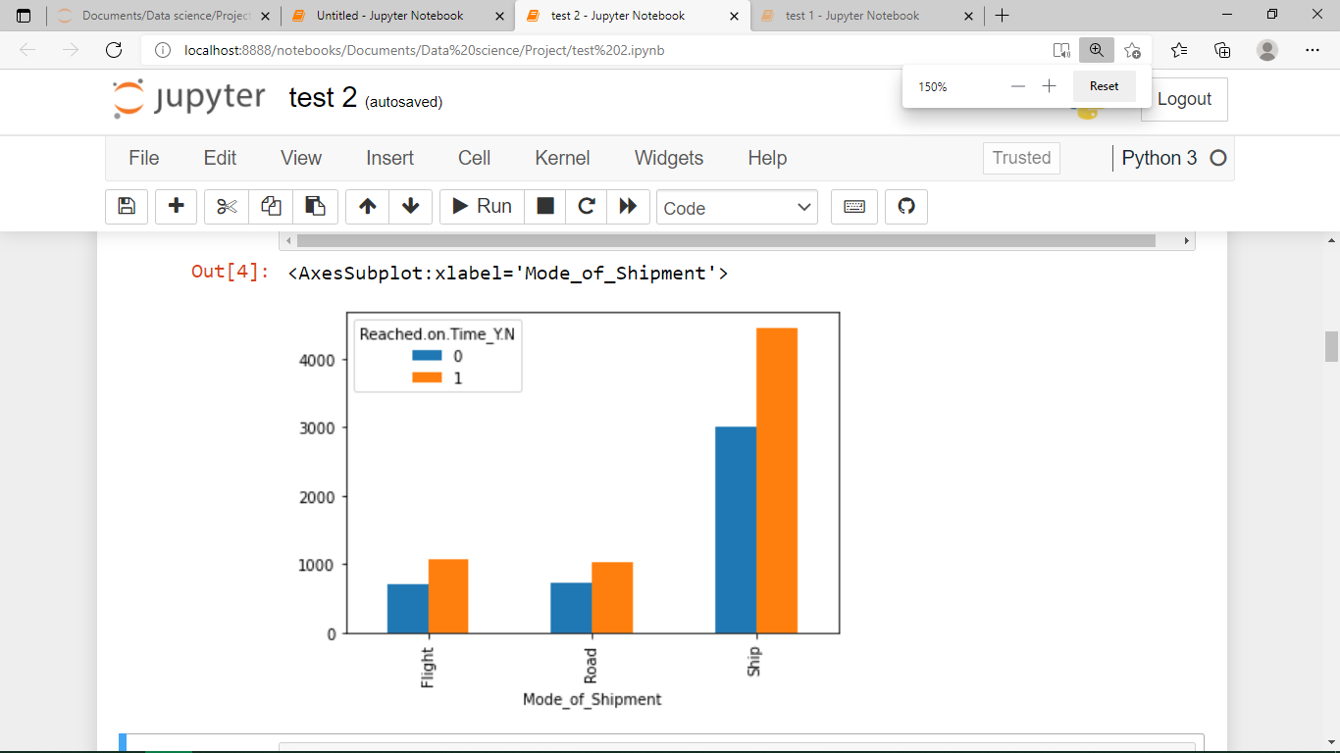
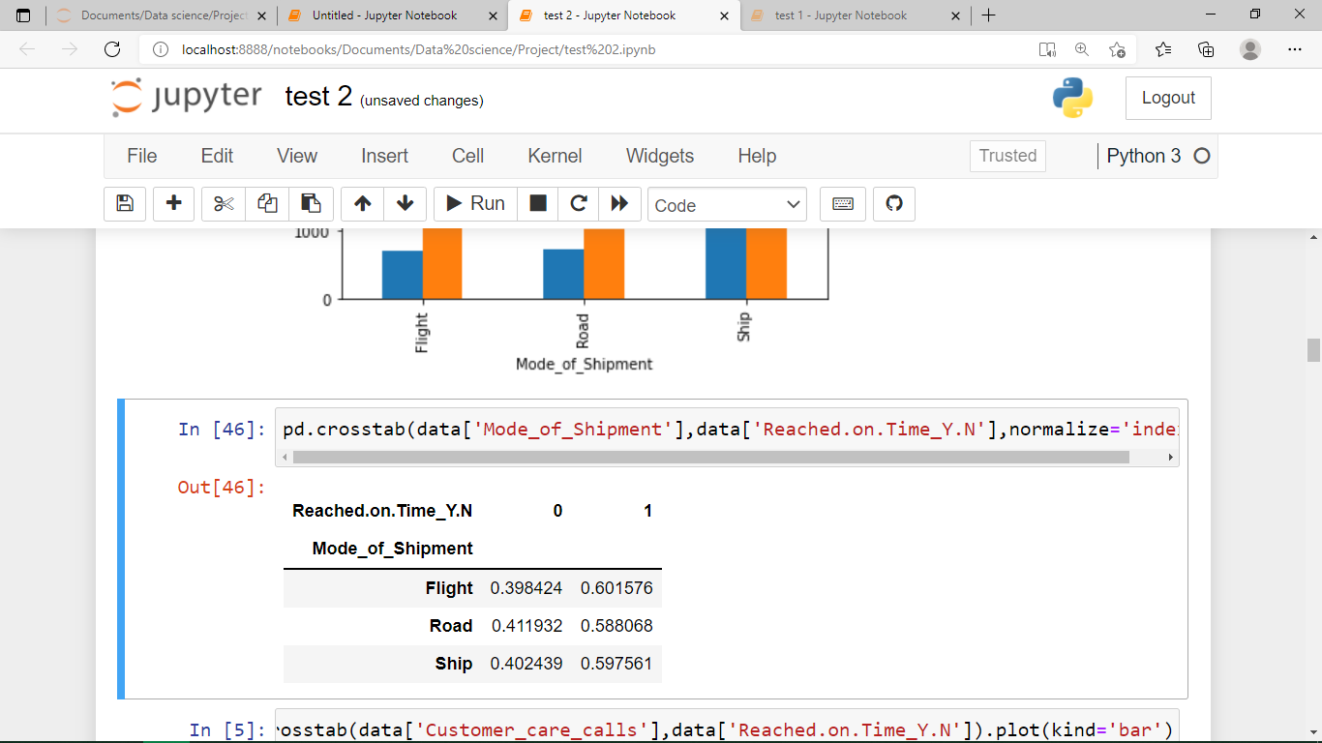
Higher No. of Shipments are done via Ship.
Less variance is found between all 3 modes of shipment in delivering shipment on time.

Slide 9
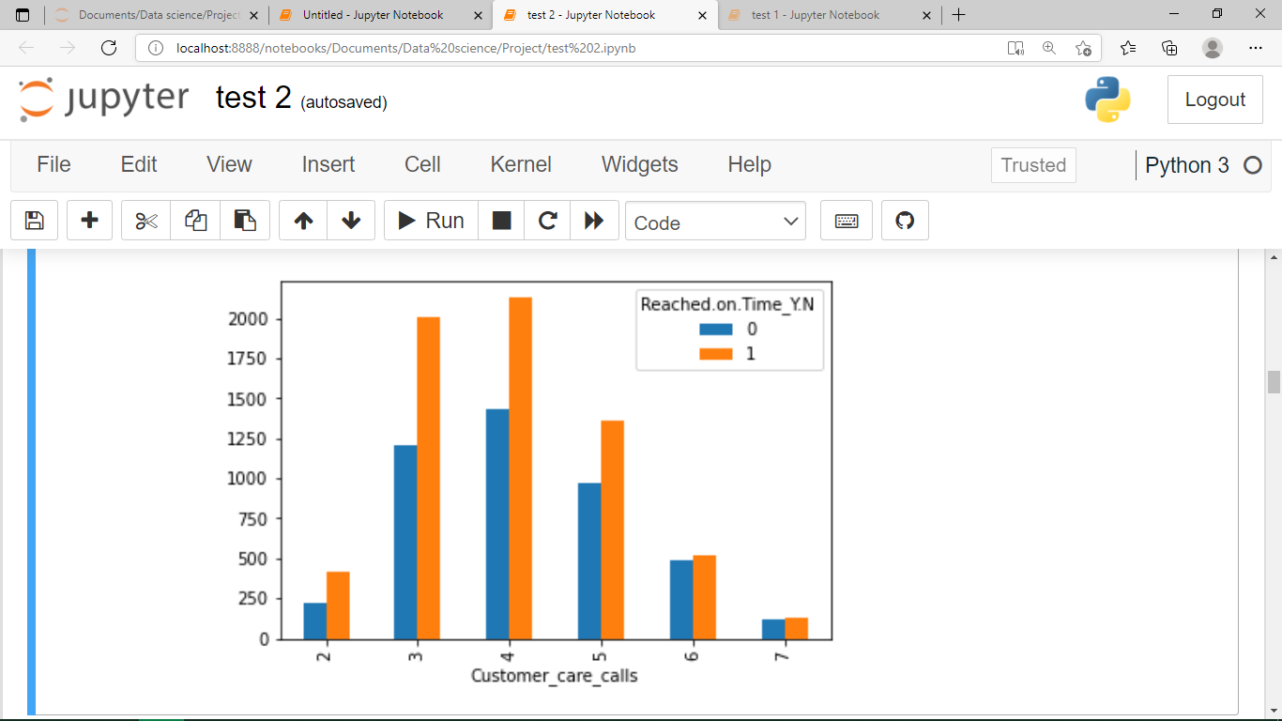
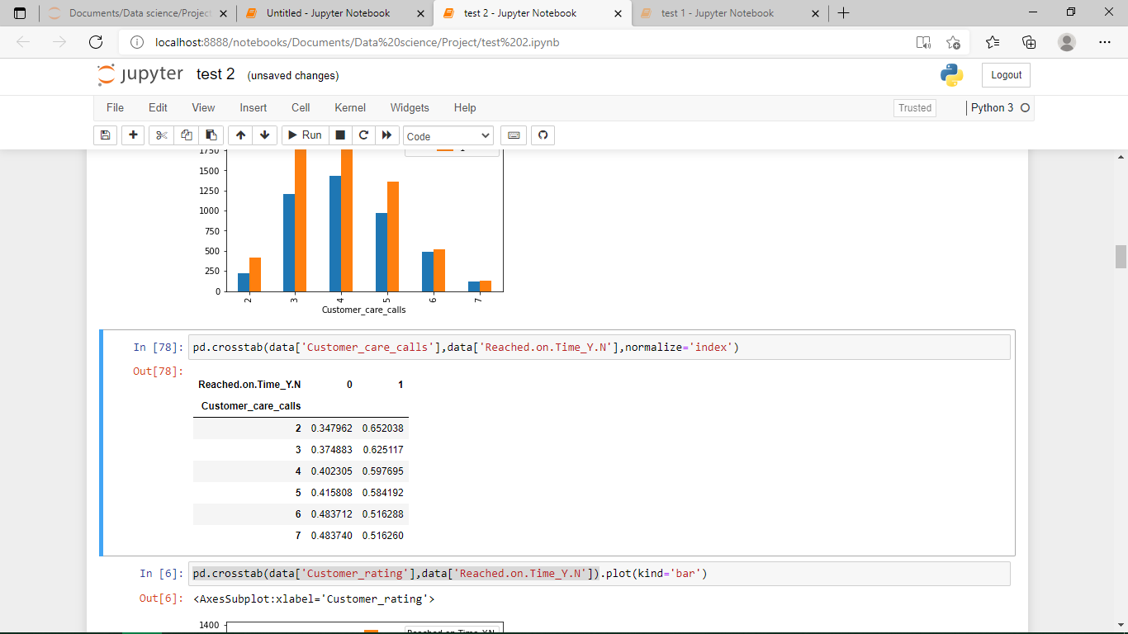
Customers who have made more no. of calls about the enquiry of the shipment, have a good chance of receiving the product on time.

Slide 10
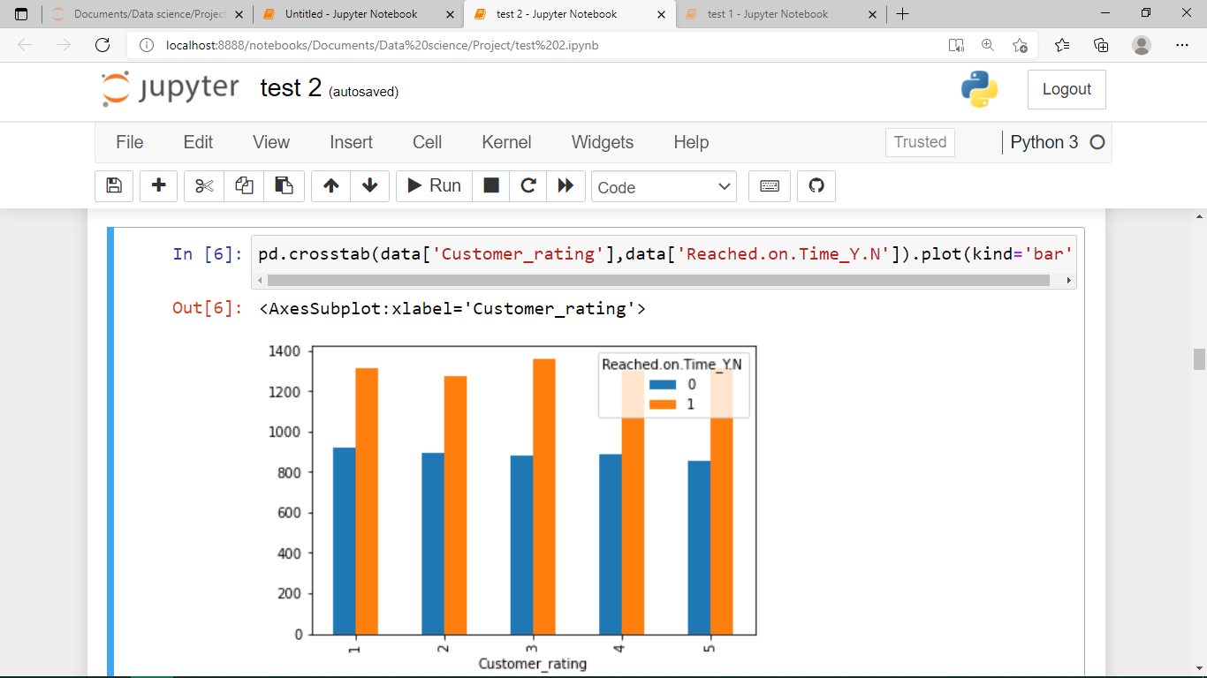
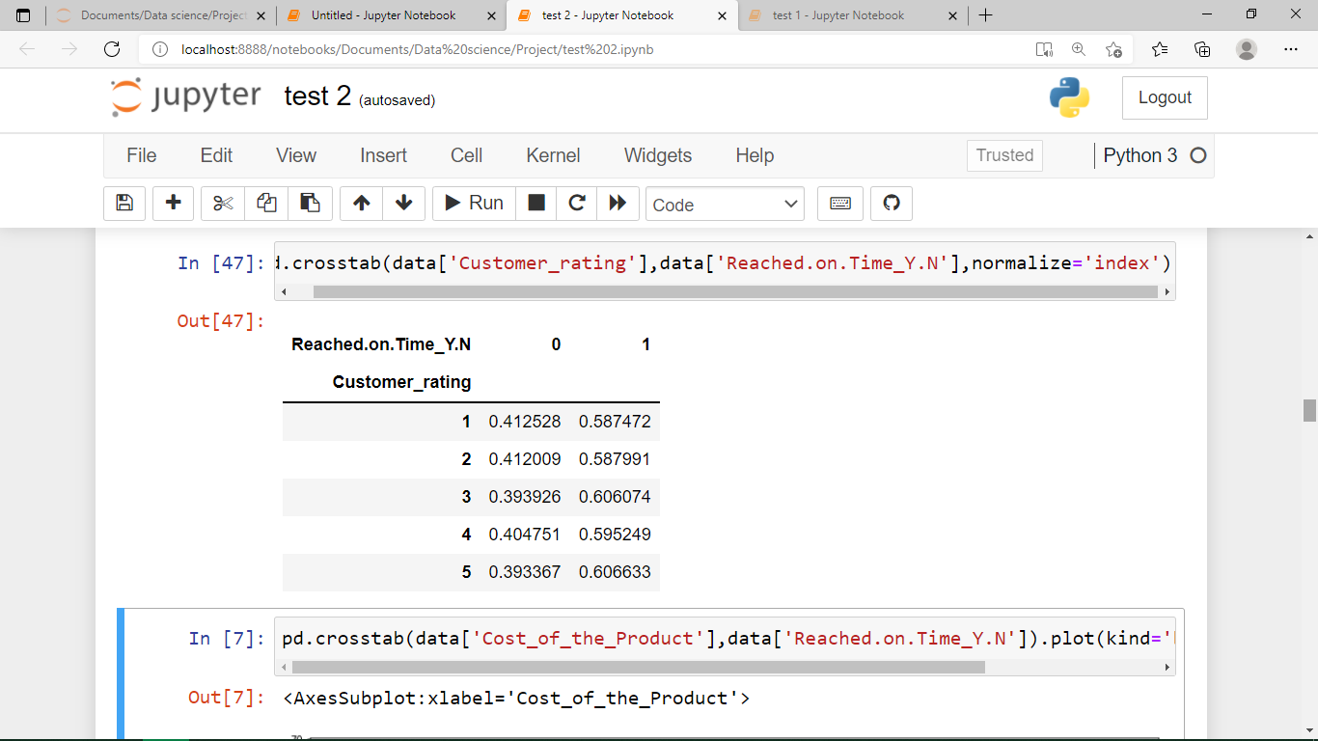
Customer rating doesn’t shows much impact on ‘delivering the shipment on time’

Slide 11
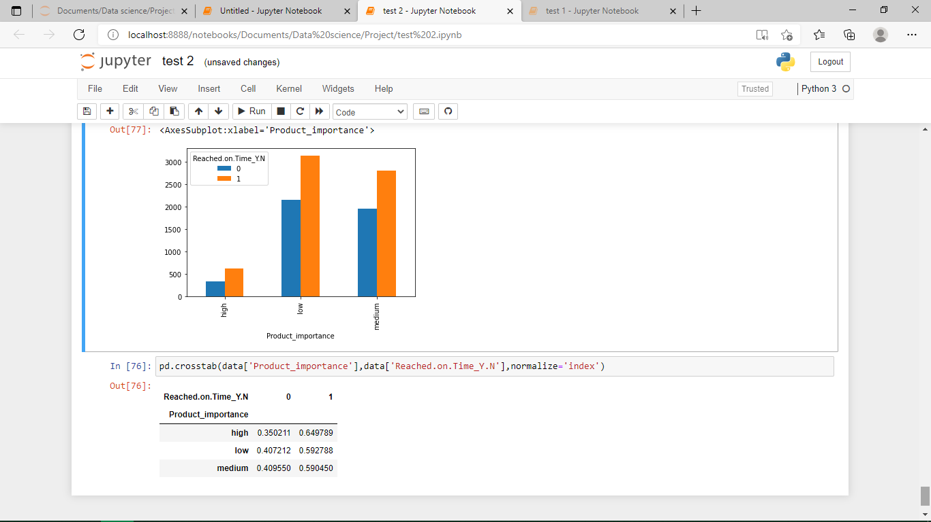
Products of high importance have comparatively less probability to reach on time, rather than low and medium important products.

Slide 12
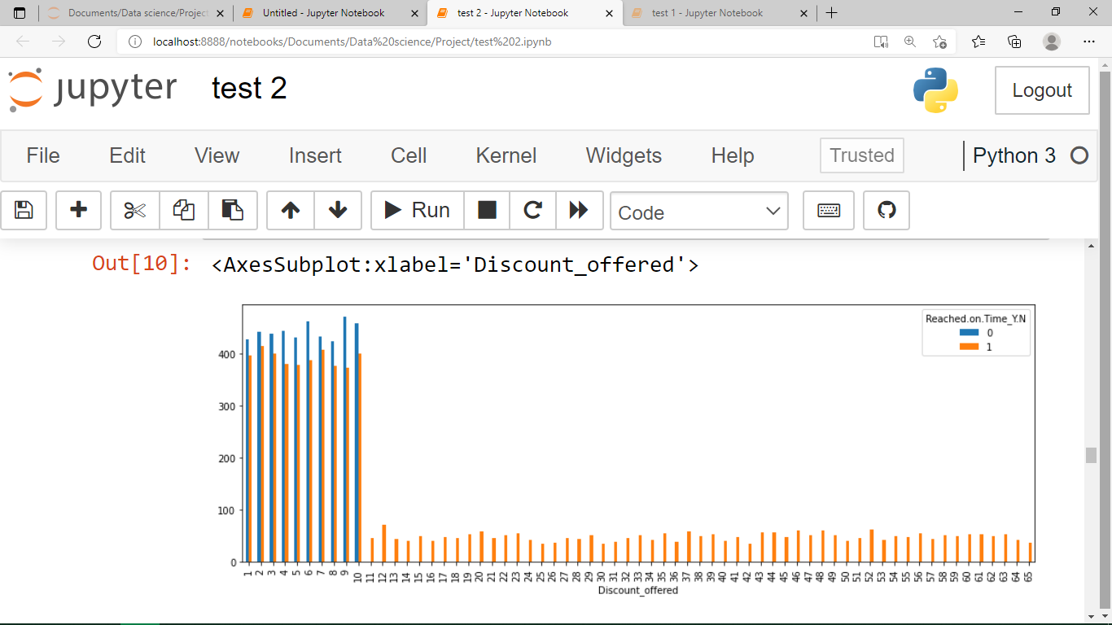
Items with discount>10 have not reached on time. And more no. of products with discount<10 have reached on time.

Slide 13
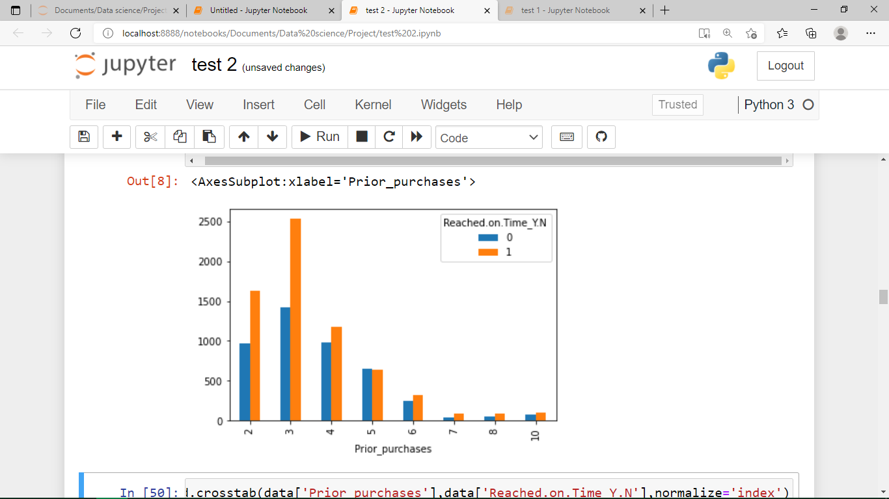
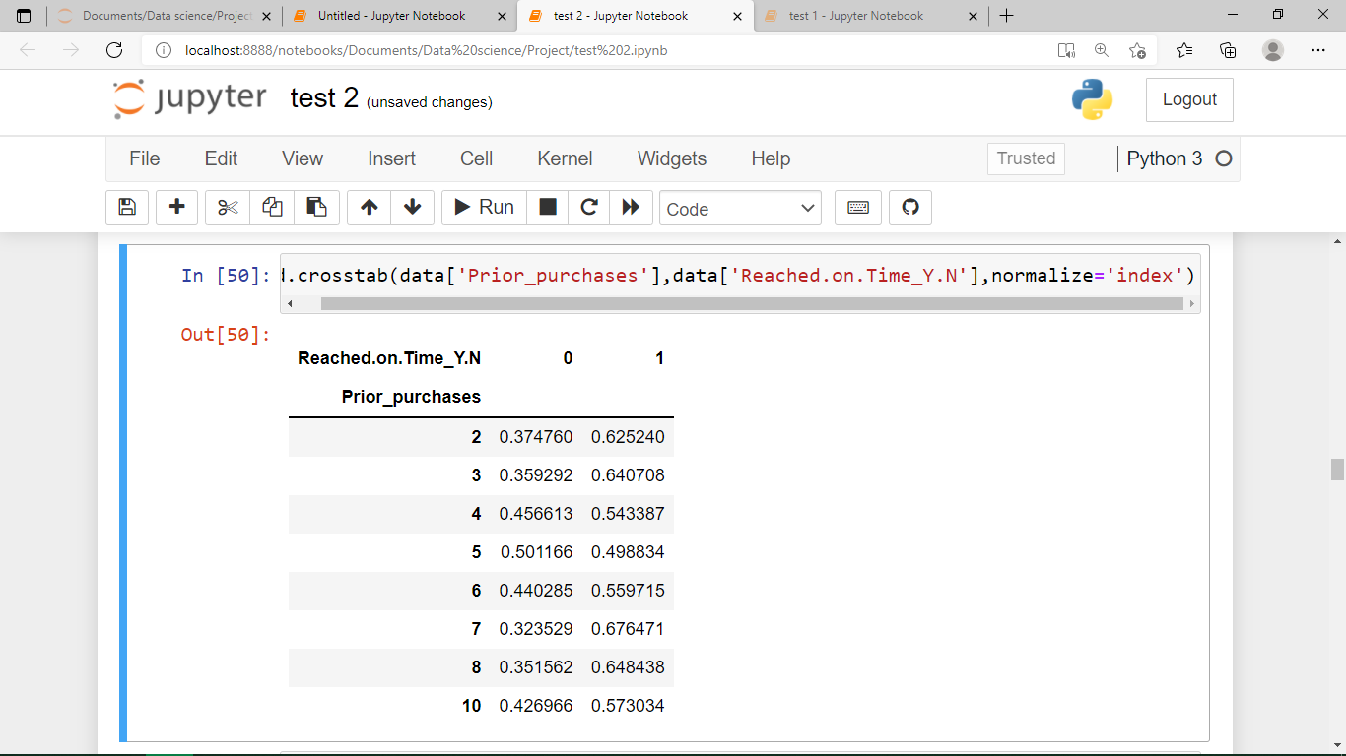
Customers with 5 no’s of prior purchases have 50% of chances to receive the shipment on time.
Apart from that it doesn’t have any impact on greater than or less than 5 reviews.

Slide 14
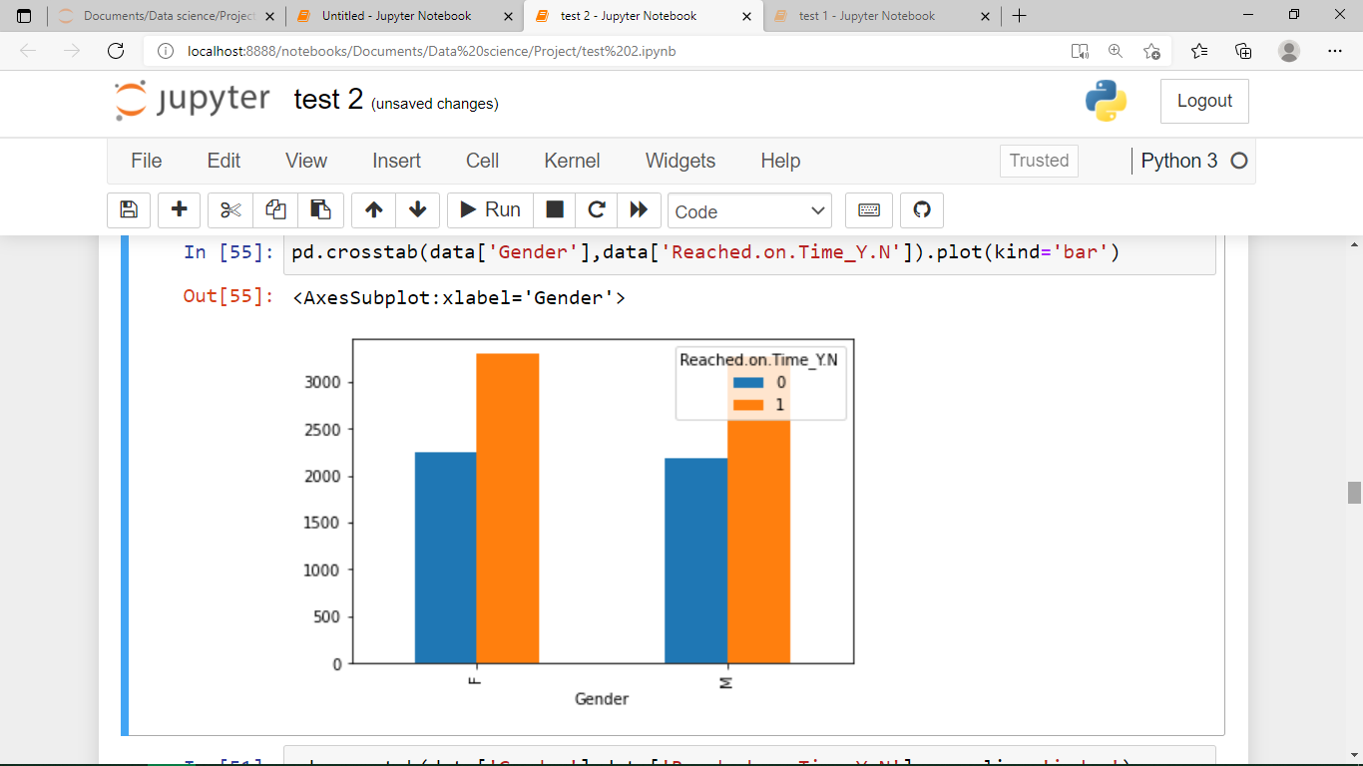
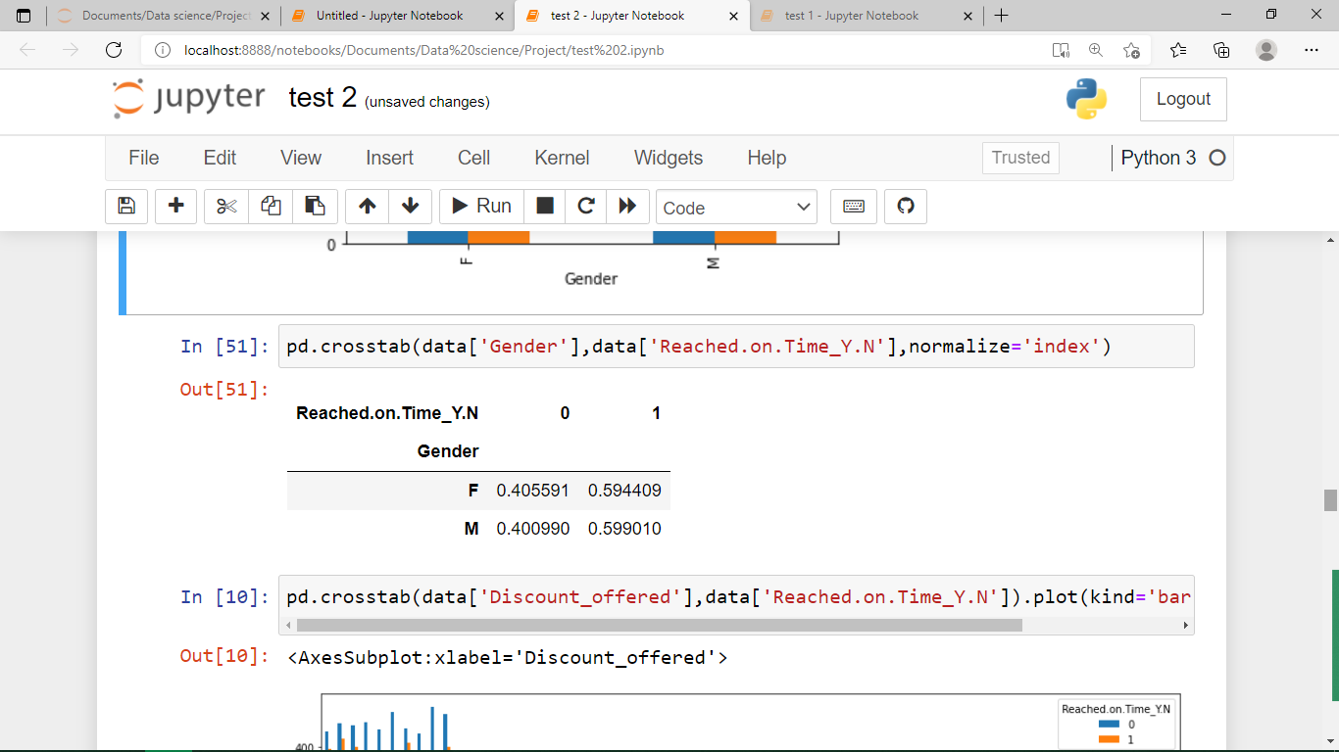
Gender doesn’t looks like a feature which can cause any variance in ‘delivering shipments on time’.

Slide 15
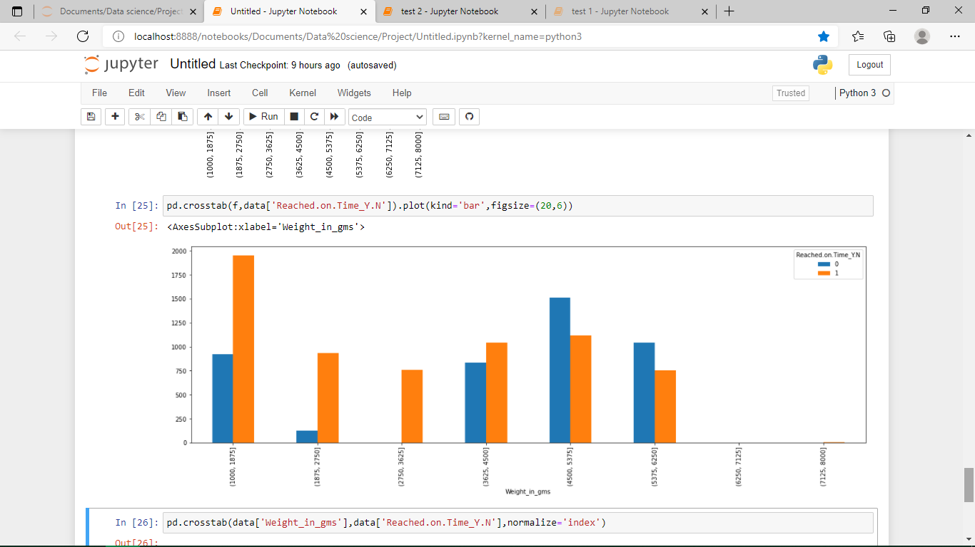
‘Weight of the product’ above 4500 has high possibility of ‘delivered on time’.
Weight of the product between 2750 to 3625 has very less possibility of ‘delivered on time’.

Slide 16
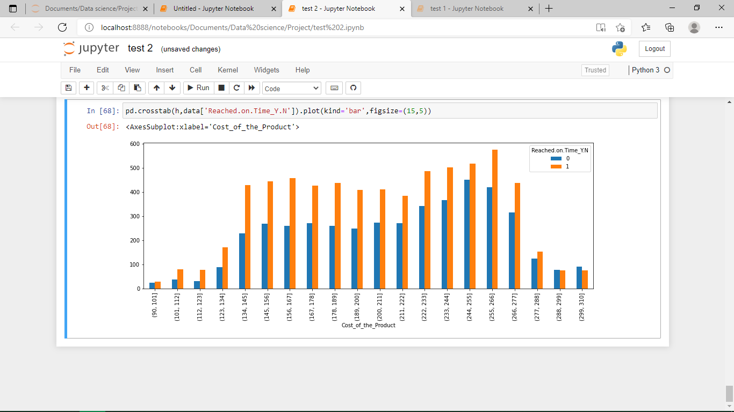
‘Cost of the product’ above 288 has high chances for delivered on time.

Slide 17
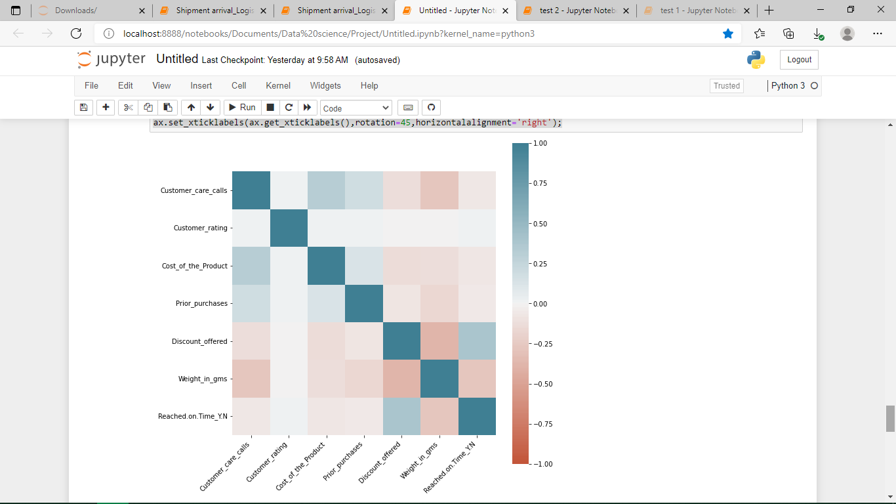
Correlation Map for continuous varriables

Slide 18
Feature Engineering

Slide 19
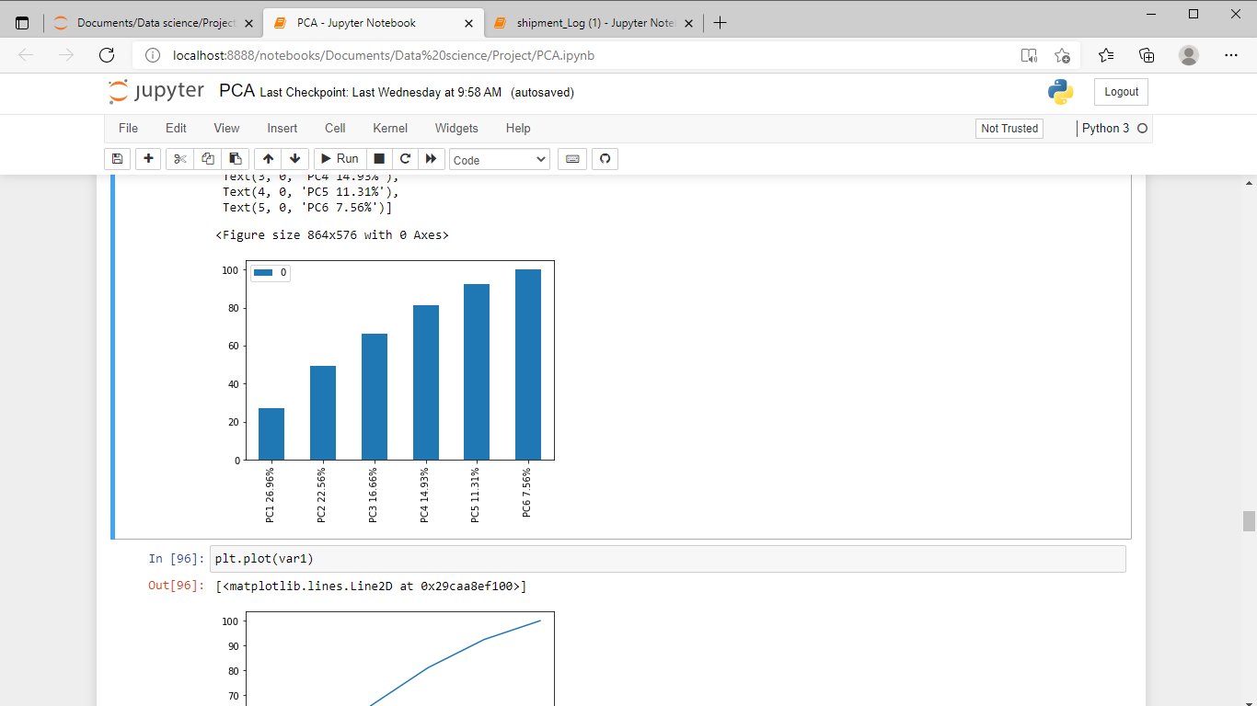
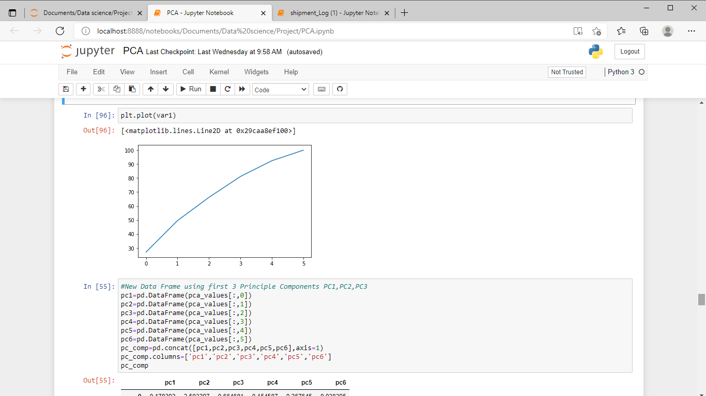
Feature Engineering
Principle Component Analysis:

Slide 20
Feature Engineering
Principle Component Analysis:
Only 6 no’s of continuous variable's used for Principle component analysis.
First two PCA components contains more percentage of information.
Limitations:
Only continuous variable’s can be used for PCA, so the vast number of discrete variable’s cant be taken into account.
At least 4 Principle components required to include 80% of information.

Slide 21
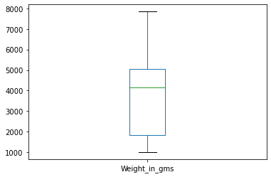
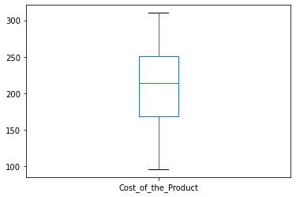
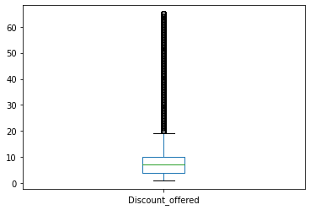
Feature Engineering
Outliers Detection:
*Third Box Plot reveals that ,we have more outliers in column named ‘Discount_Offered’

Slide 22
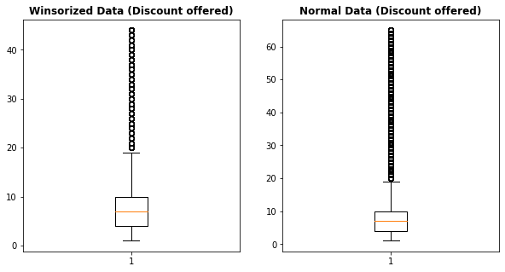
Feature Engineering
Handling Outliers using Winsorization :
#Handling Outliers with winsorization
from scipy.stats.mstats import winsorize
data_win= winsorize(data["Discount_offered"],(0,0.10))

Slide 23
Feature Engineering
ENCODING :
1.) Drop ID column
data = data.drop('ID', axis=1)
data = data.drop('Gender', axis=1)
We dropped Both the ID and Gender columns it does not effect our model building.
2.) One hot encoding
data = pd.get_dummies(data, columns=["Warehouse_block"])
data = pd.get_dummies(data, columns=["Mode_of_Shipment"])
data = pd.get_dummies(data, columns=["Product_importance"])

Slide 24
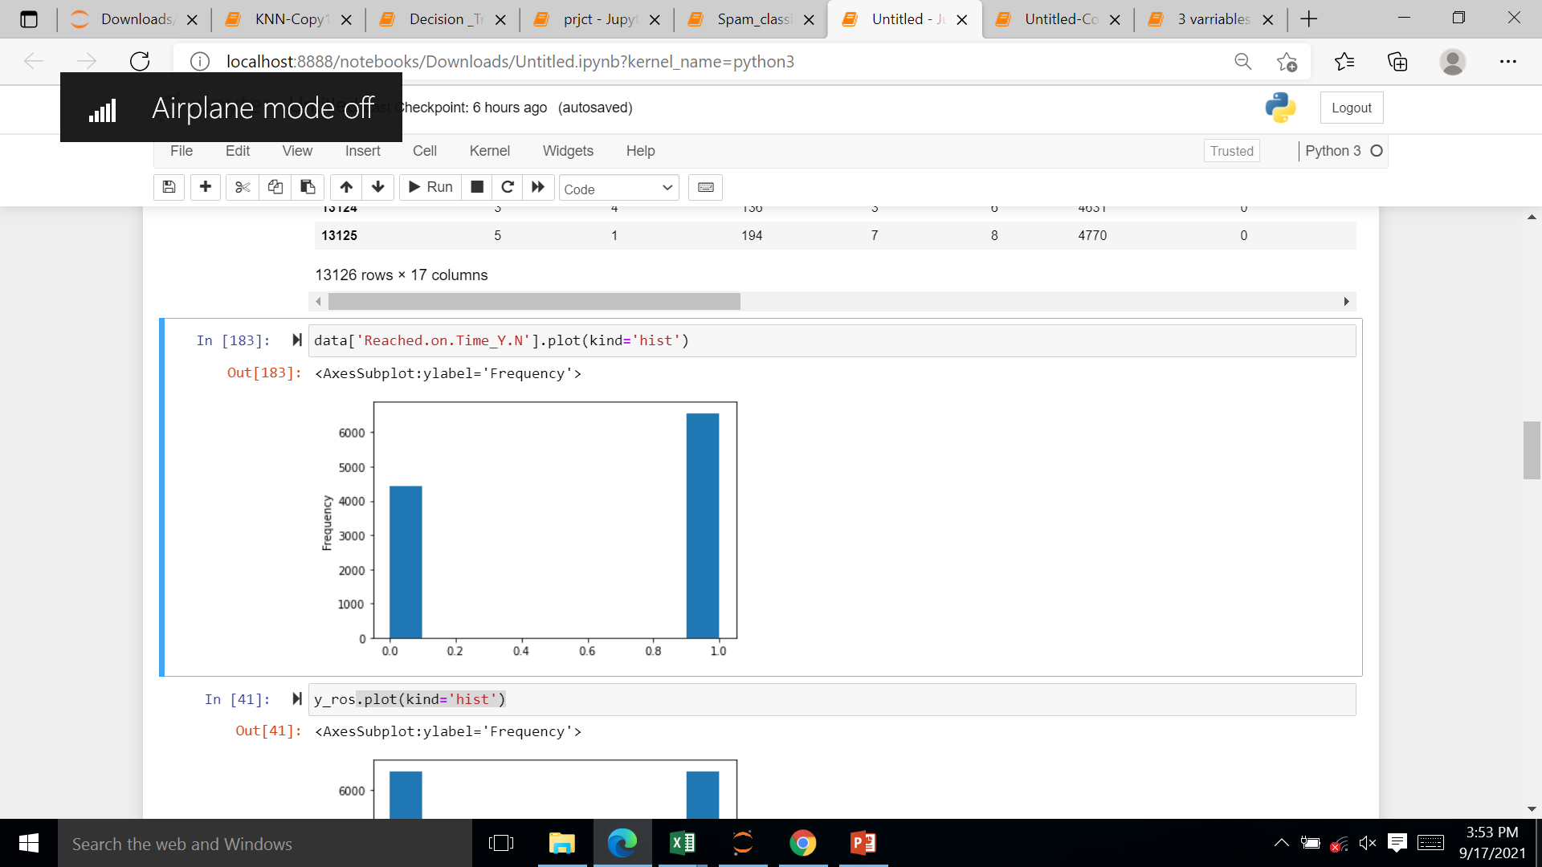
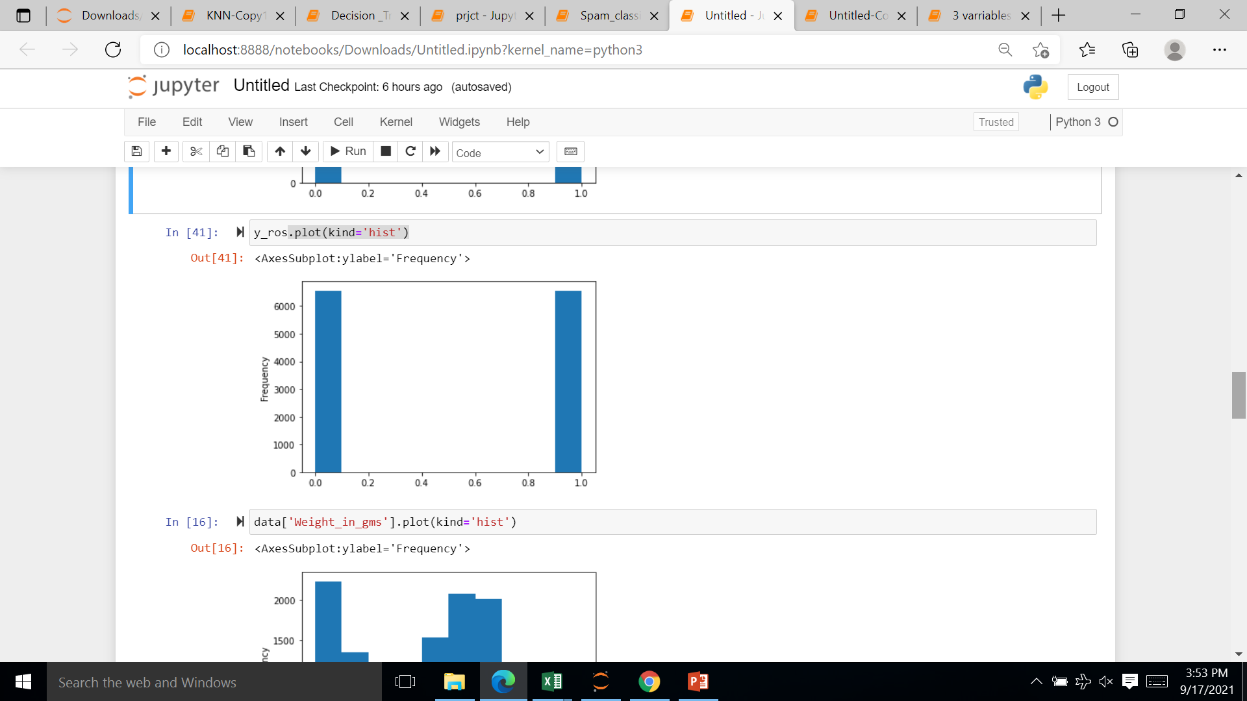
Feature Engineering
Over Sampling The Target Variable:
Before Over Sampling Process
After Over Sampling Process
#code
ros = RandomOverSampler(sampling_strategy='minority')
# resampling X, y
X_ros, y_ros = ros.fit_resample(X, y)
# new class distribution
print(Counter(y_ros))

Slide 25
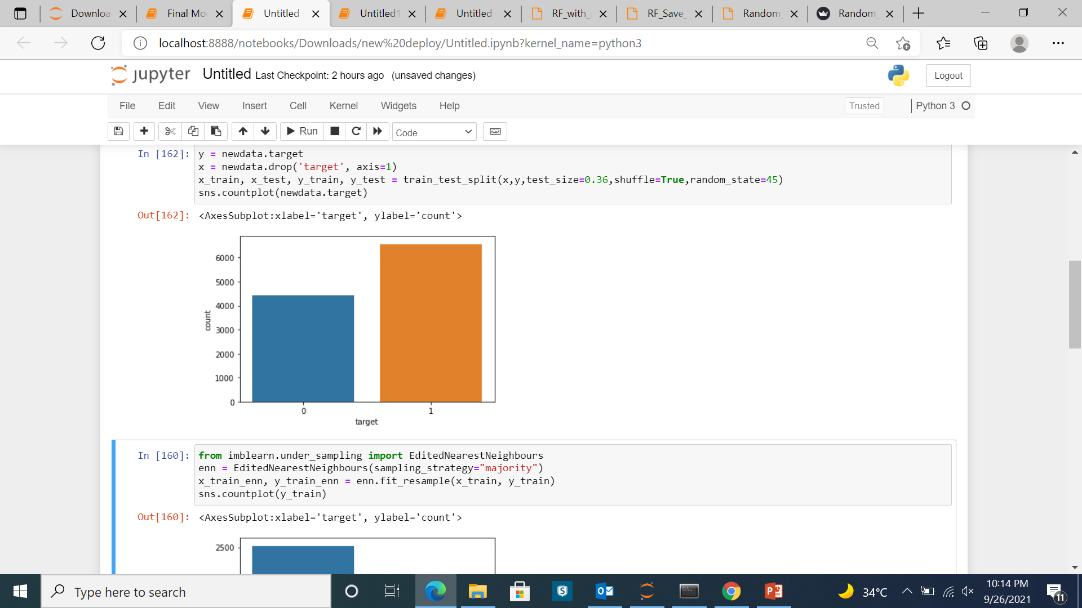
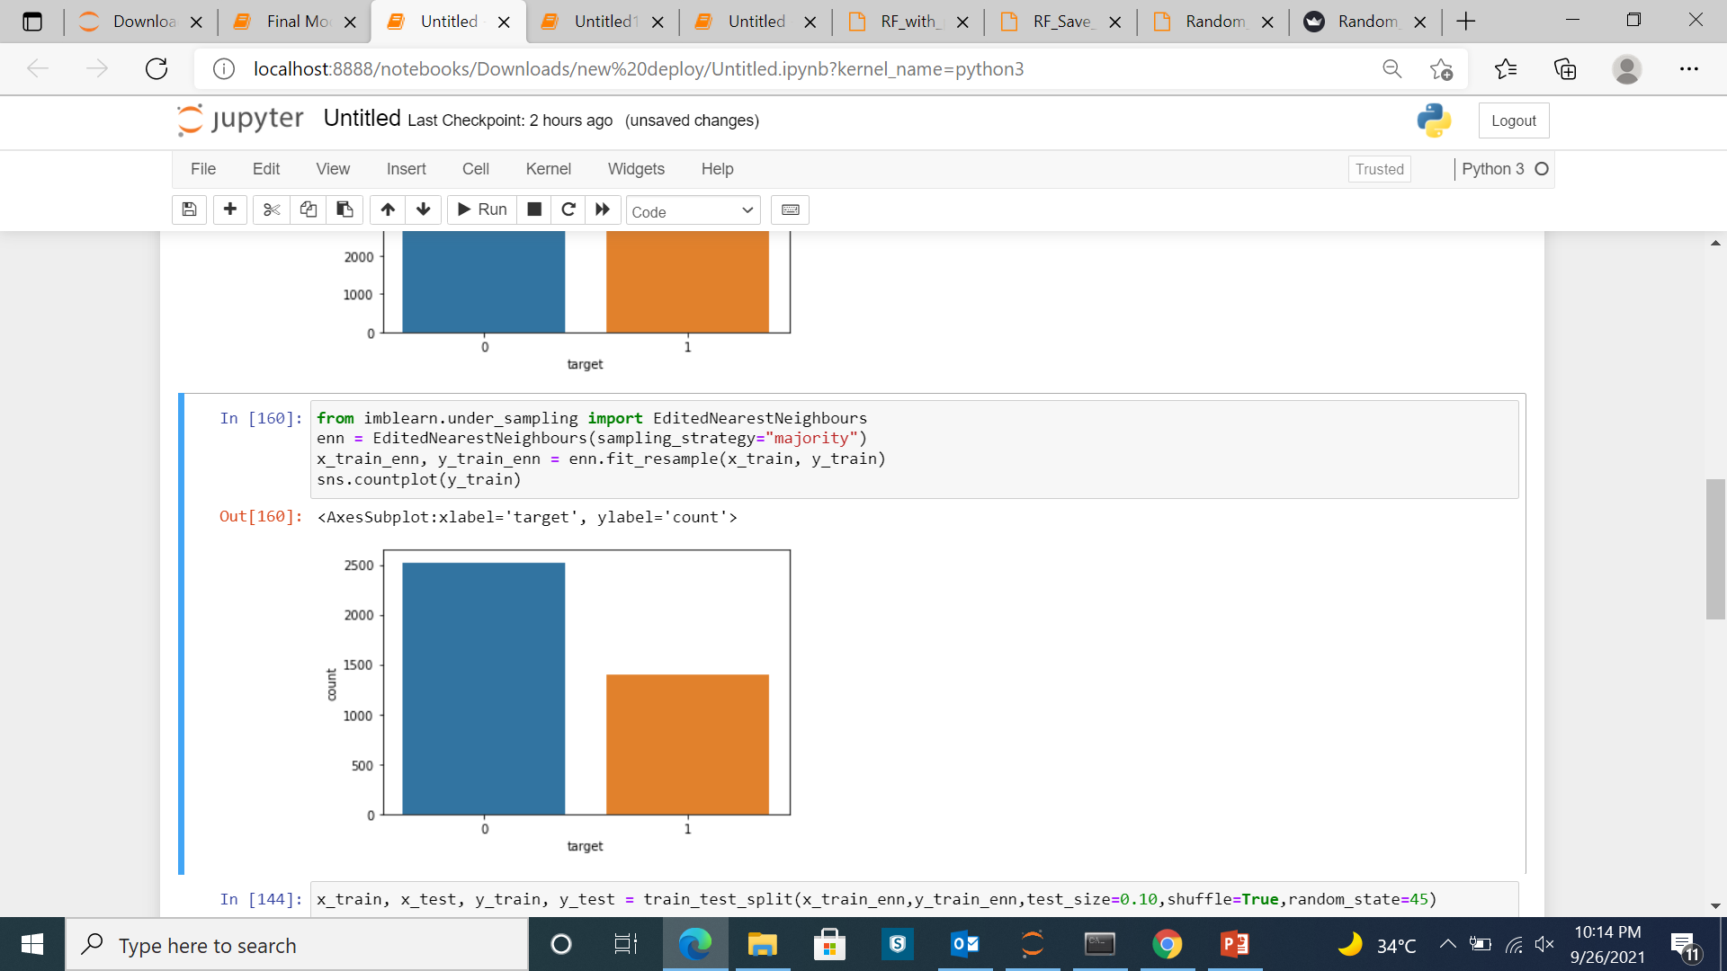
Feature Engineering
Near Miss Sampling The Target Variable:
Before Sampling Process
After Sampling Process
#code
ros = RandomOverSampler(sampling_strategy='minority')
# resampling X, y
X_ros, y_ros = ros.fit_resample(X, y)
# new class distribution
print(Counter(y_ros))

Slide 26
Model Building

Slide 27
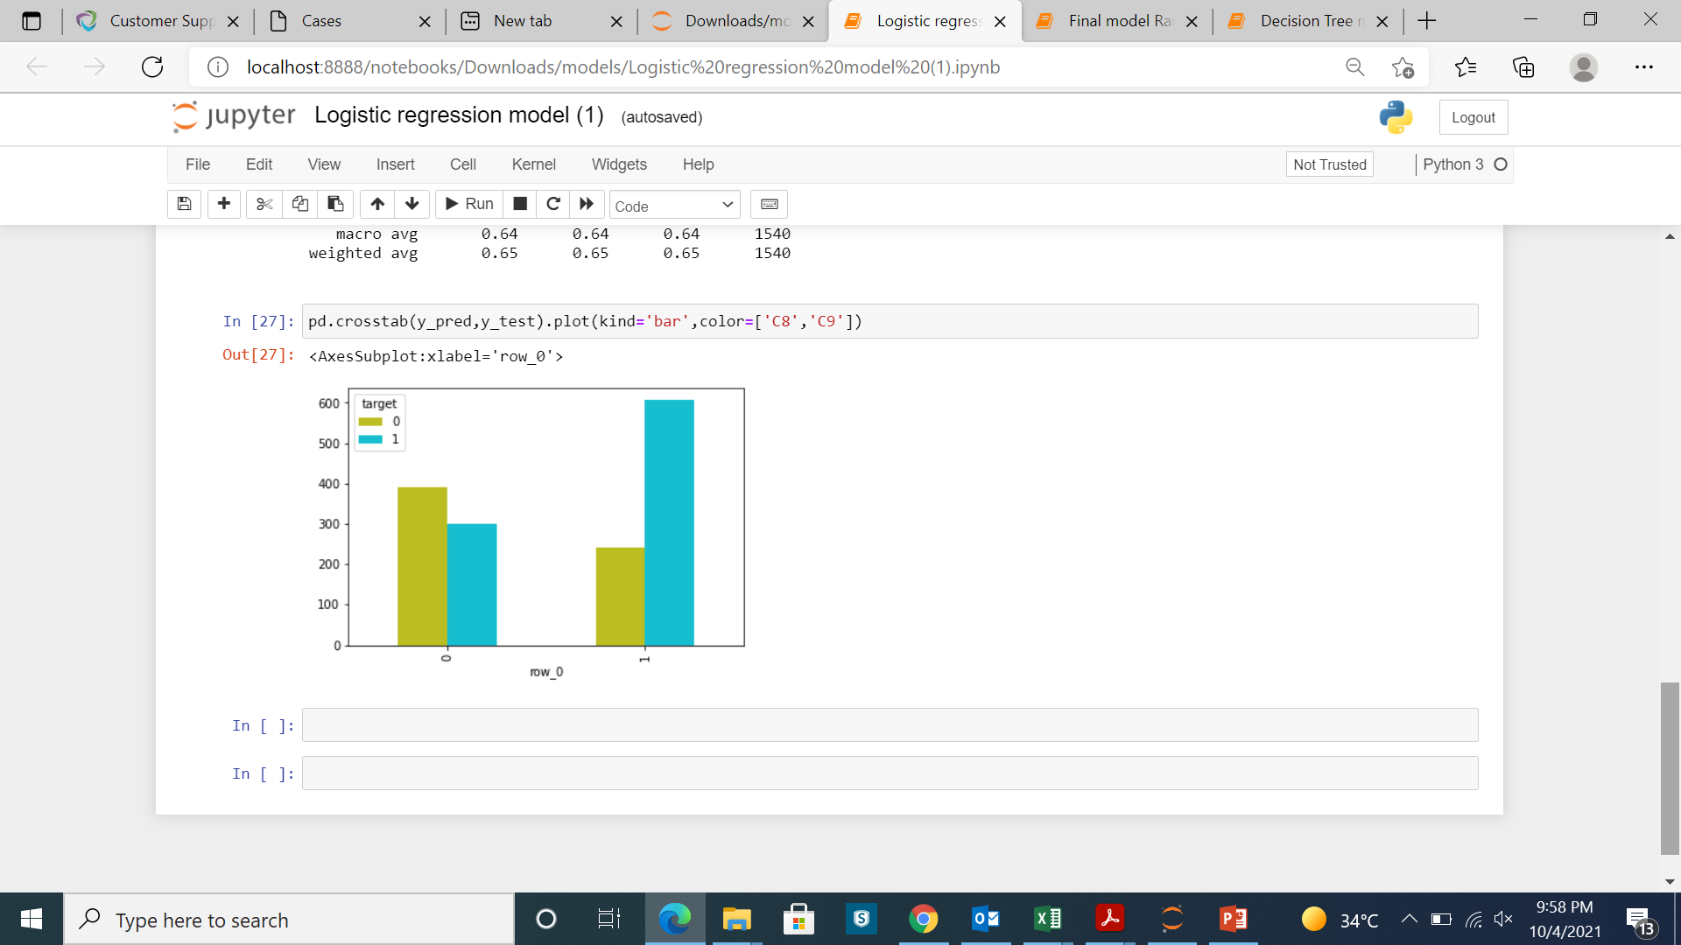
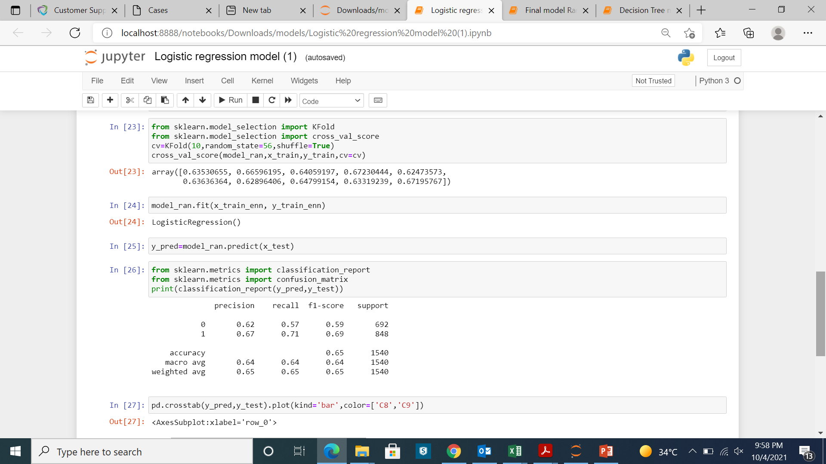
Model Building:
Algorithm used : Logistic Regression
Training Accuracy :67%
Testing Accuracy : 65%

Slide 28
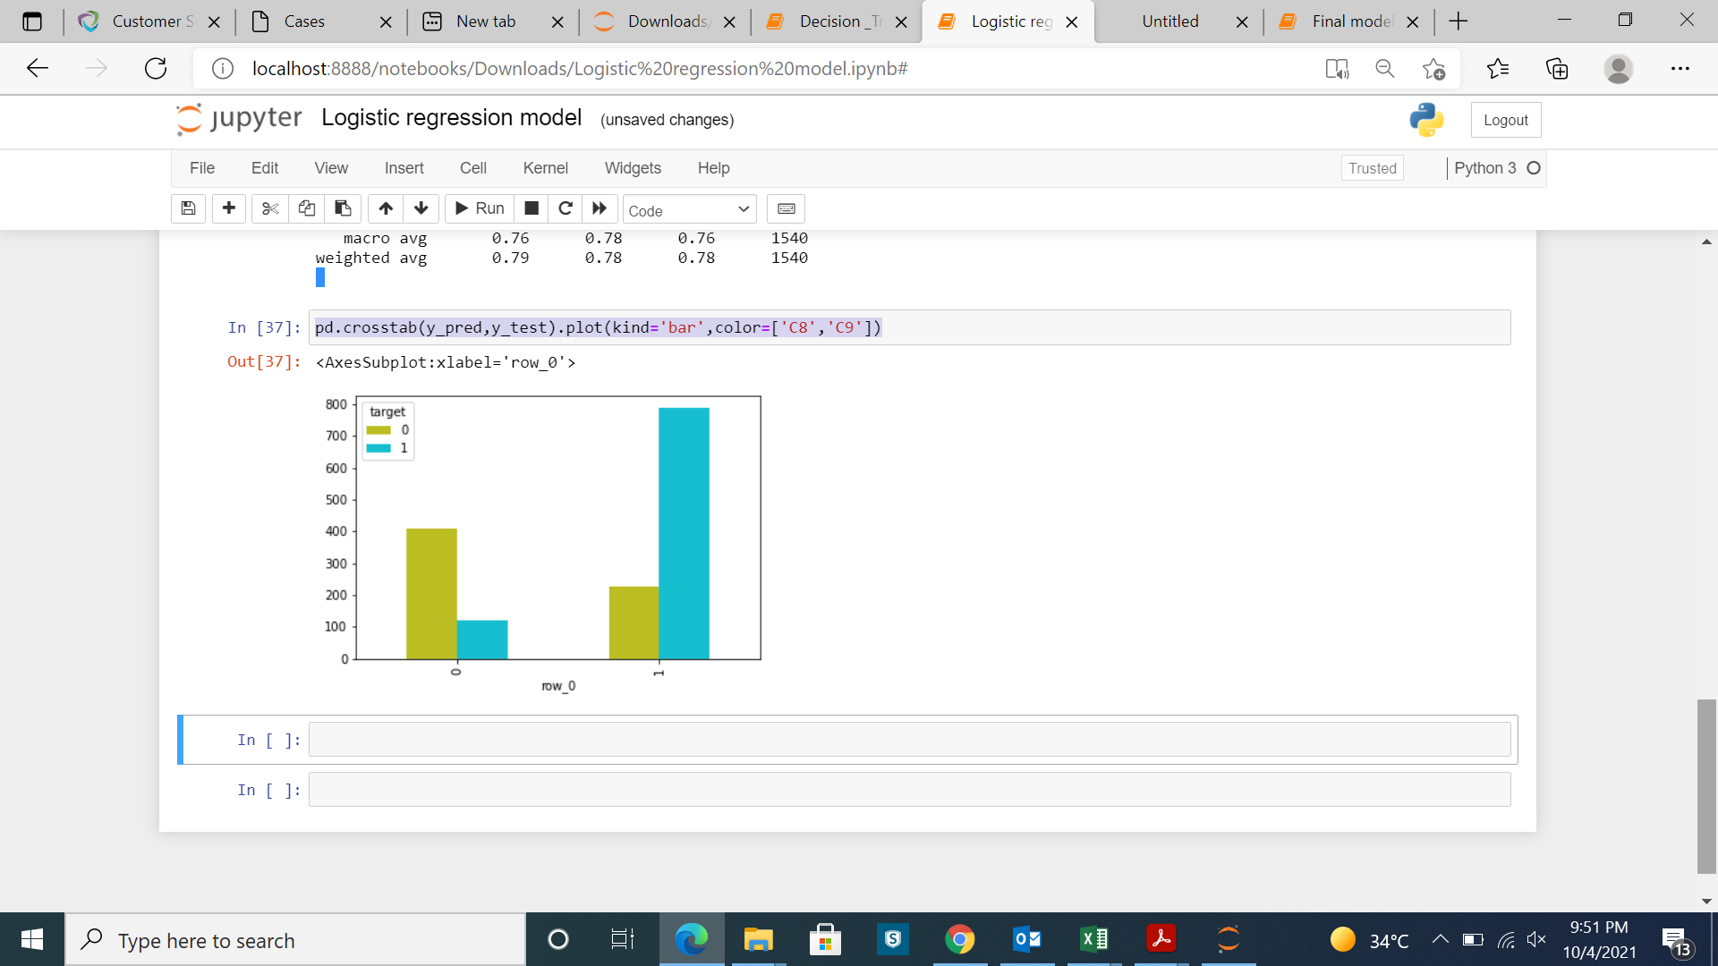
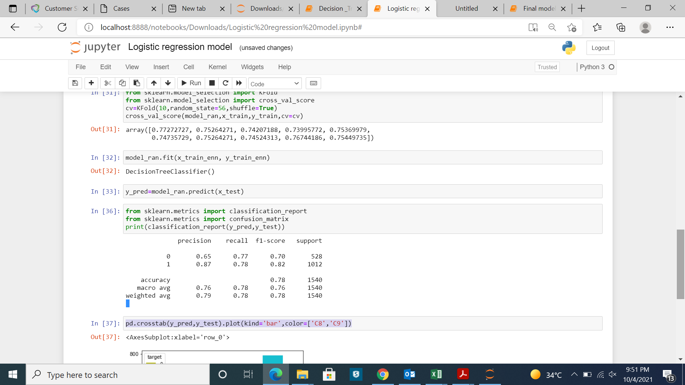
Model Building:
Algorithm used : Decision Tree Classifier
Training Accuracy: 78%
Testing Accuracy: 78%

Slide 29
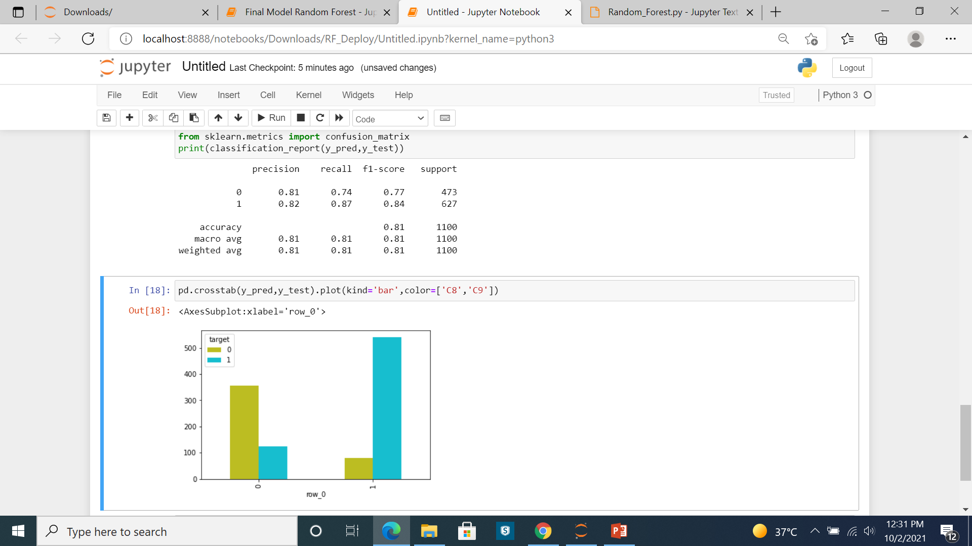
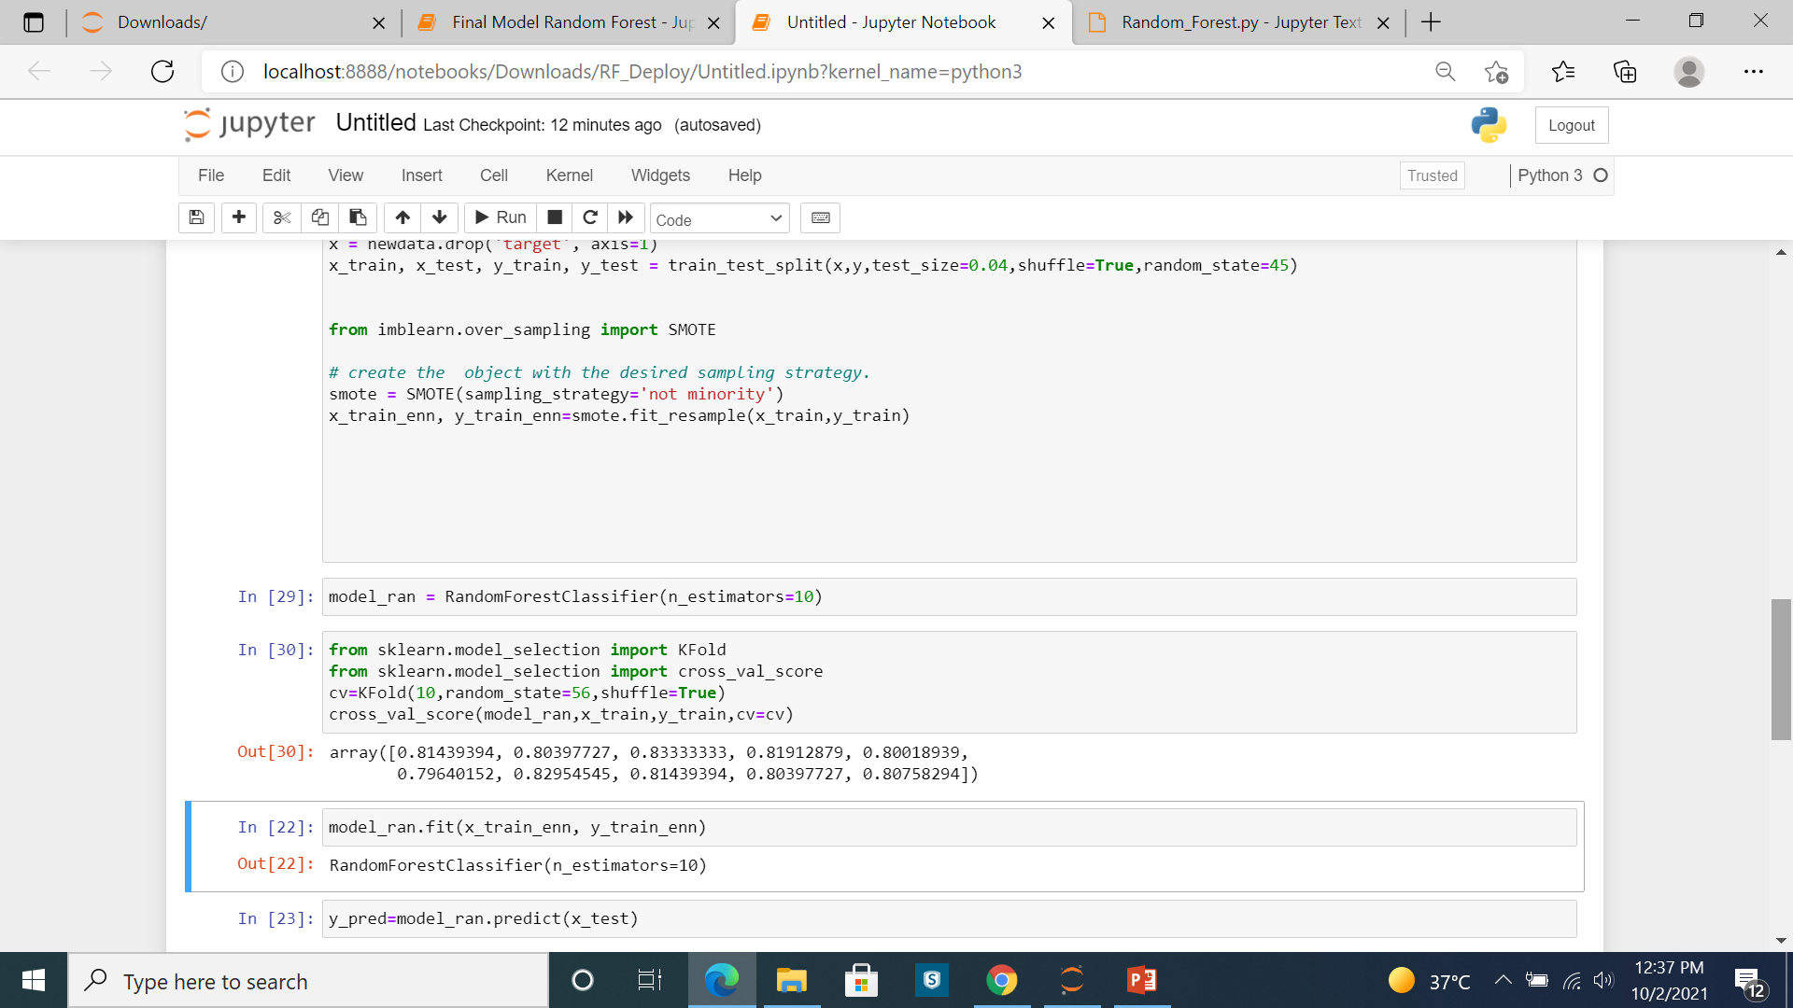
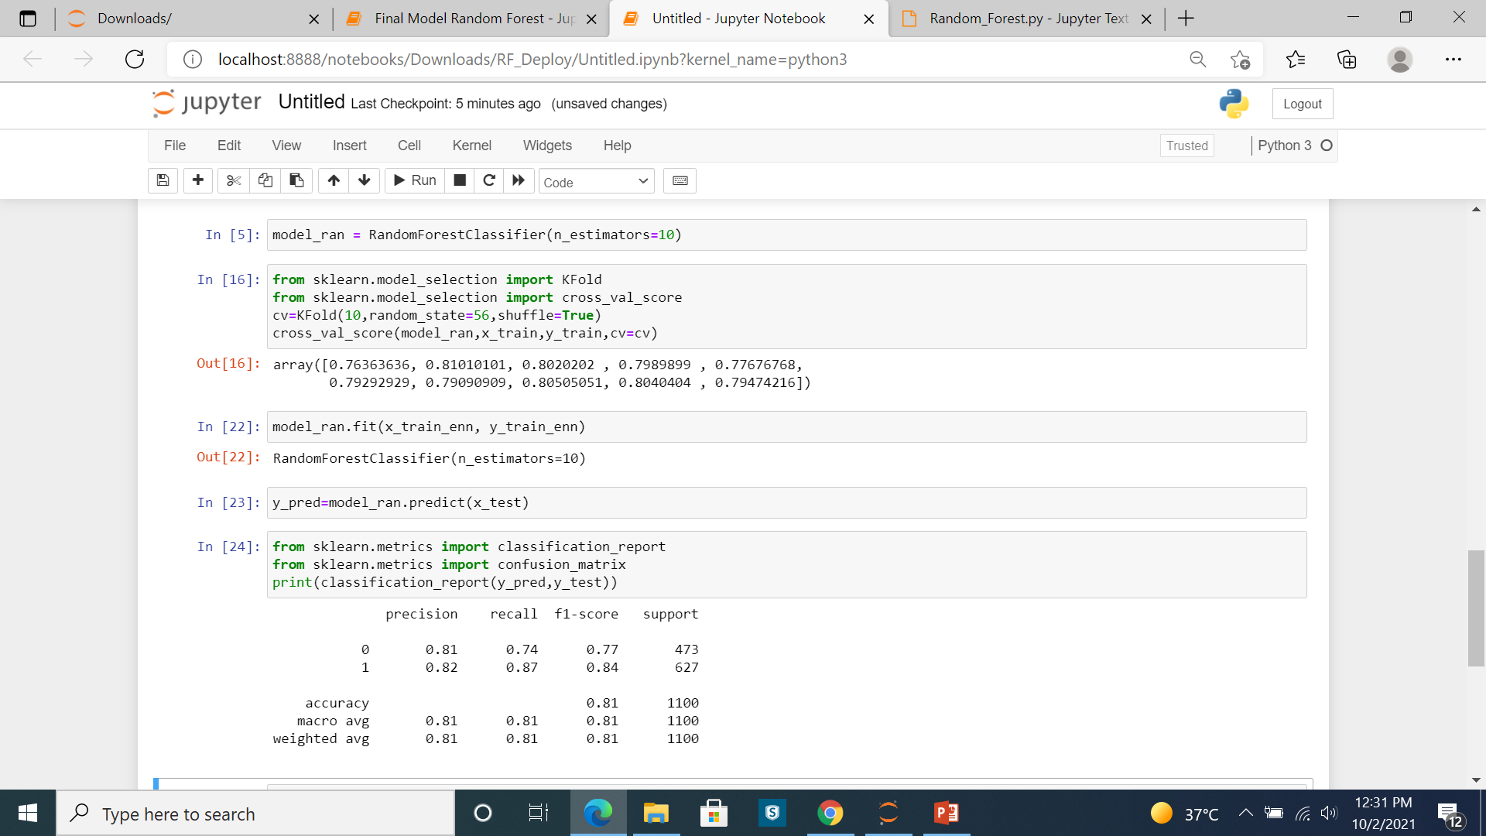
Model Building : Final model
Algorithm used : Random Forest Classifier
Training Accuracy : 83.01%
Testing Accuracy : 81%

Slide 30
Thank You

